Slide 1
Survey Research
Experimental Psychology

Slide 2
Survey Research
Survey research
Self-report measures
Large sample size (respondents)

Slide 3
Types of Questions
Closed-ended
E.g., “How old are you?”
___ 18-24
___ 25-30
___ 31-35
___ 35-40
___ 40+
Open-ended
E.g., “What do you enjoy about your job?”
Pros and cons of each?

Slide 4
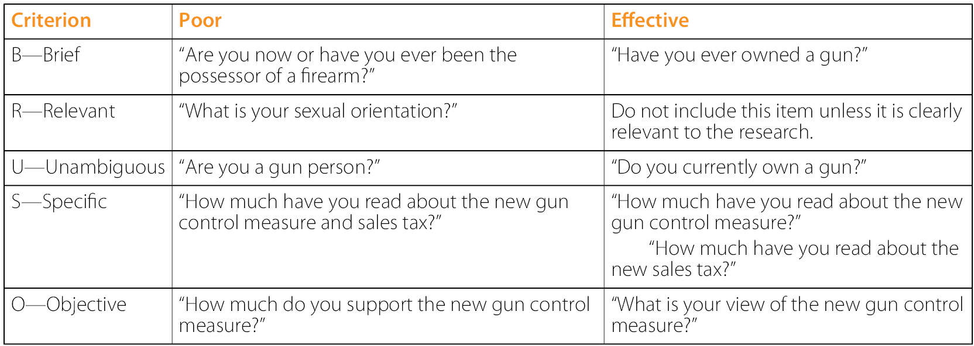
BRUSO: How to write good survey items

Slide 5
Creating your own questions
Write a closed-ended and open-ended survey question for each of the following general questions, keeping “BRUSO” in mind.
How much does the respondent use Facebook?
How much exercise does the respondent get?

Slide 6
Context Effects on Survey Questions
Context effect: Context affects responses
Item-order effect: Responses are affected by earlier survey questions

Slide 7
Survey Formats
In-person
Highest response rate
Mail
Online
Mail and online have low response rates
Phone

Slide 8
Biases in Surveys
Sampling bias- when sample is not representative of the population
Nonresponse bias- those who respond to surveys are inherently different than those who do not

